Slide 1
MuleSoft Catalyst Approach

Slide 2

Only 1 of 10 IT projects succeed during delivery
10%
Common reasons for failure
Lack of alignment around business outcomes
Lack of organizational enablement
Took too long to realize value
% of IT projects that are delivered on time, on budget, and meeting the technical objectives*
*Source: The Standish Group’s CHAOS Report, 2011 and 2013

Slide 3
MuleSoft Catalyst is our unique approach which enables our customers to achieve their outcomes while avoiding common pitfalls

Slide 4

What is MuleSoft Catalyst?
MuleSoft Catalyst brings together our outcomes-driven methodology, assets, and services to help drive your business transformation
Methodology
Assets
Services
A step-by-step approach to guide your implementation
Customer-validated assets to accelerate your delivery
Tailored services led by MuleSoft and our partners

Slide 5
Only 1 of 10 IT projects succeed during delivery
10%
Common reasons for failure
Lack of alignment around business outcomes
Lack of organizational enablement
Took too long to realize value
% of IT projects that are delivered on time, on budget, and meeting the technical objectives*
*Source: The Standish Group’s CHAOS Report, 2011 and 2013

Slide 6
MuleSoft Catalyst is our unique approach which enables our customers to achieve their outcomes while avoiding common pitfalls
Notes:
Mulesoft catalyst is our unique approach which enables customers to achieve their outcomes while avoiding the most common pitfalls.
Transition: So what is the MuleSoft Catalyst approach?
TIP:
Before you jump into content, confirm that the CIO’s objectives are aligned with yours and she is clearly leaning in to learn from our POV on how our customers are achieving success with our platform.
Depending on where you are in the sales cycle, you’ve likely already identified their business pain and understand their current challenges. If you’ve built a case for action with your client, you should playback the business outcomes discussed before diving into the presentation.

Slide 7
What is MuleSoft Catalyst?
MuleSoft Catalyst brings together our outcomes-driven methodology, assets, and services to help drive your business transformation
Methodology
Assets
Services
A step-by-step approach to guide your implementation
Customer-validated assets to accelerate your delivery
Tailored services led by MuleSoft and our partners

Slide 8

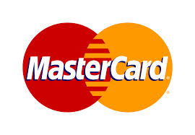








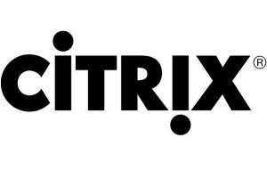

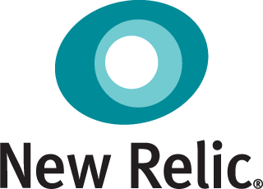















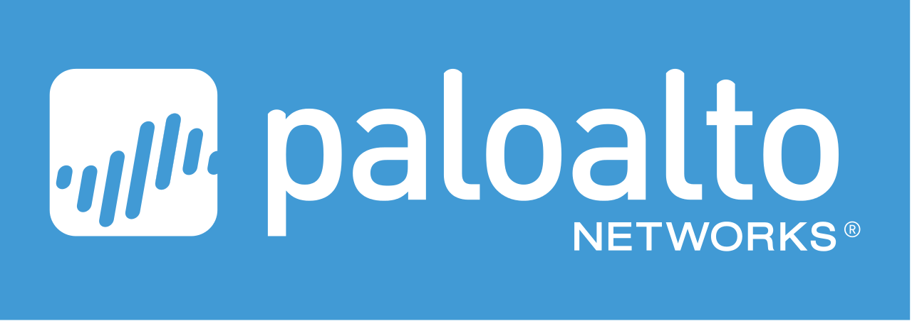








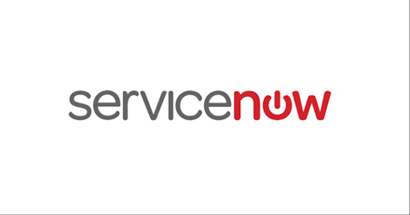





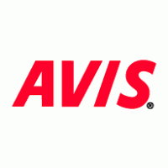


































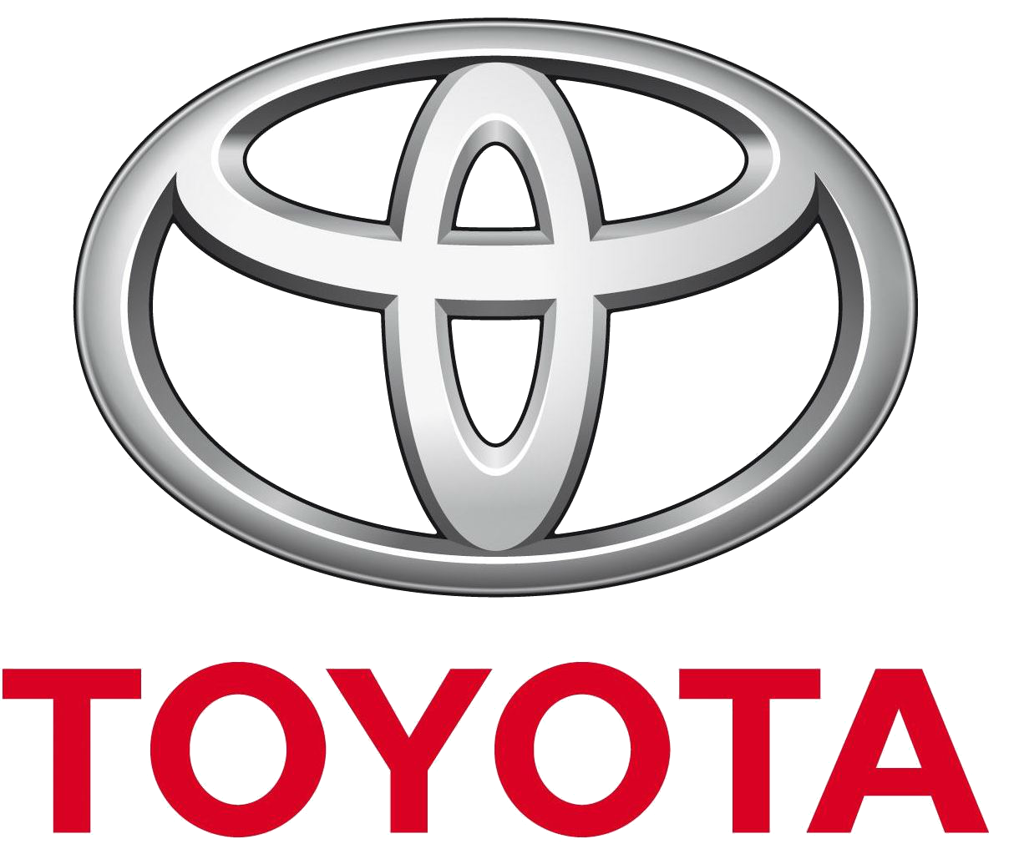




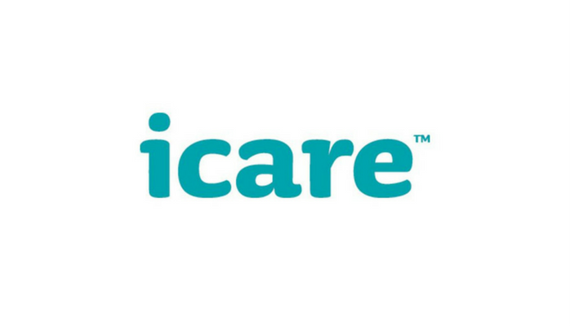






Based on our experience with >1,700 customers
Financial Services and Insurance
Retail and Consumer Goods
High Tech
Education and Public Sector
Healthcare
Healthcare
Education and Public Sector
Manufacturing
Notes:
Slides takeaway: MuleSoft has a unique delivery approach to avoid those pitfalls and make you successful. It’s based on best practices from our work with 1000+ customers.
We said let's codify experience with 1,700 customers, let's package that all up and share it with all existing, every new customer. So everybody gets the cumulative experience of all our existing install base. And we know it works.
Transition: How do we know?

Slide 9
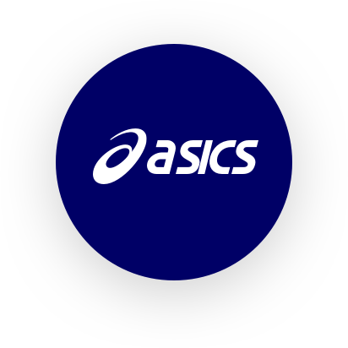







Measurable benefits from Catalyst - examples
Benefit
Customer Examples
Faster development speed
1
2.5x increase in integration development speed, from 2.5 months to 4 weeks
30% reduction in integration maintenance costs. Top 10 global bank
Reduced maintenance costs
2
Platform
Value
>290K transactions processed daily on customer mobile app
3
Improved scalability & stability
IT projects delivered 4x quicker
with MuleSoft
Quicker time to market
4
More innovation
5
36% increase in sales conversion with in-store digital app
Business
Value
Greater agility
6
New business initiatives launched 3-4x faster, from months to days

Slide 10
Catalyst Methodology
Notes:
Let me walk you through the three elements of our approach.

Slide 11




Catalyst Methodology centered around 3 core pillars
Business outcomes
Customer success
Customer success
Technology delivery
Organization enablement

Slide 12


6 paths to focus on
 |  | Plan for success | Establish the foundation | Build to scale | Measure impact
 |  | Business outcomes path
 |  | Anypoint Platform path
 |  | Projects path
 |  | Center for Enablement “C4E” path
 |  | Internal support path
 |  | Training path
Business
outcomes
Technology delivery
Org enablement

Slide 13

6 playbooks to guide you
 |  | Plan for success | Establish the foundation | Build to scale | Measure impact
 |  | Business outcomes playbook
 |  | Anypoint Platform playbook
 |  | Projects playbook
 |  | Center for Enablement “C4E” playbook
 |  | Internal support playbook
 |  | Training playbook
Business
outcomes
Technology delivery
Org enablement
Notes:
\

Slide 14
Catalyst Methodology Playbook example
Anypoint Platform Playbook
Plan for success |  | Establish the foundation | Build to scale | Measure impact
Define Anypoint Platform Vision and Roadmap | Design Anypoint Platform Architecture and Implementation Plan | Deploy Anypoint Platform | Scale and Refine Anypoint Platform | Measure Anypoint Platform KPIs
Define the Vision for Anypoint Platform Alignment with strategic goals Architectural Principles and Standards Stakeholder questions and concerns Validate Vision with Relevant Enterprise Architecture and Operations Stakeholders Define key Anypoint platform Roadmap and Map to Overall Success Plan Establish Anypoint platform KPI’s and Measurement Plan | Establish Anypoint platform Architecture Define Common Services Establish DevOps Approach Define API/Integration Lifecycle Management and Governance Processes Define the Anypoint Platform Operational Model Validate Compliance of Architecture Build Anypoint Platform, implementation plan to support key milestones Develop the Anypoint Platform Test Plan Develop the Anypoint Platform Upgrade Plan Develop the Anypoint Platform DR Plan | Install Anypoint Platform Install and Setup Common Services Execute Anypoint Platform Test Plan Transfer Ownership to Operations/Support Team Set up CI/CD pipelines | Gather Feedback from Project Teams Review and Modify Anypoint Platform KPI’s Plan for Demand of Current and Future Projects Review and Update Anypoint Platform Architecture Refine the Anypoint Platform Refine CI/CD Pipelines Upgrade Anypoint Platform, as Applicable | Measure Anypoint platform KPIs Develop Anypoint Platform Improvement Recommendations
Activities
Steps

Slide 15
Integrated Blueprint
 |  | Plan for success | Establish the foundation | Build to scale | Measure impact
 |  | Agree on business outcomes and KPIs Develop the overall success plan | Monitor and manage | Refresh success plan | Measure business outcomes
 |  | Define Anypoint platform vision and roadmap Design Anypoint platform architecture and implementation plan | Deploy Anypoint Platform | Scale and refine Anypoint Platform | Measure Anypoint platform KPIs
 |  | Prioritize IT projects Staff and onboard delivery teams | Define solution architecture Execute projects | Onboard additional delivery teams Launch additional projects | Measure project KPIs
 |  | Assess integration capabilities Establish the C4E | Build and publish foundational assets Evangelize | Drive consumption | Measure C4E KPIs
 |  | Determine the support operating model | Staff, train and launch team Publish support guidance and self-serve materials | Support Anypoint Platform | Measure support KPIs
 |  | Train the initial team(s) | Develop the broader training plan Launch experiential learning opportunities | Train additional teams | Conduct assessment
Business
outcomes
Technology delivery
Org enablement

Slide 16
Assets
Notes:
The first resource that I want to touch on is assets...

Slide 17
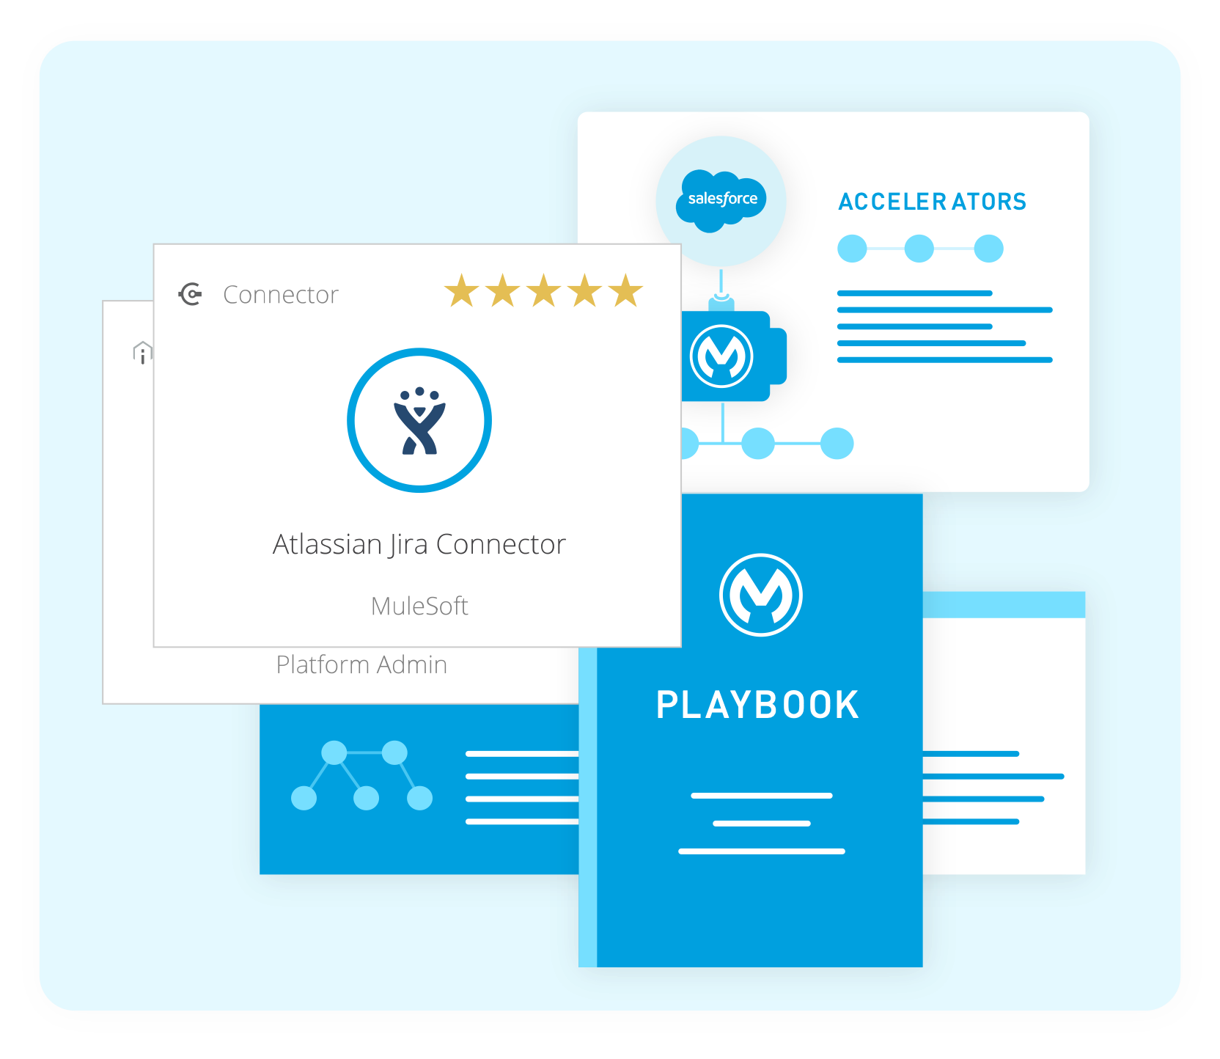
2 types of assets to help you build faster
Technical assets
Out-of-the-box assets (e.g., API fragments, code samples, connectors, accelerators, etc.)
Best practices
Playbooks, blueprints, templates and best practices

Slide 18
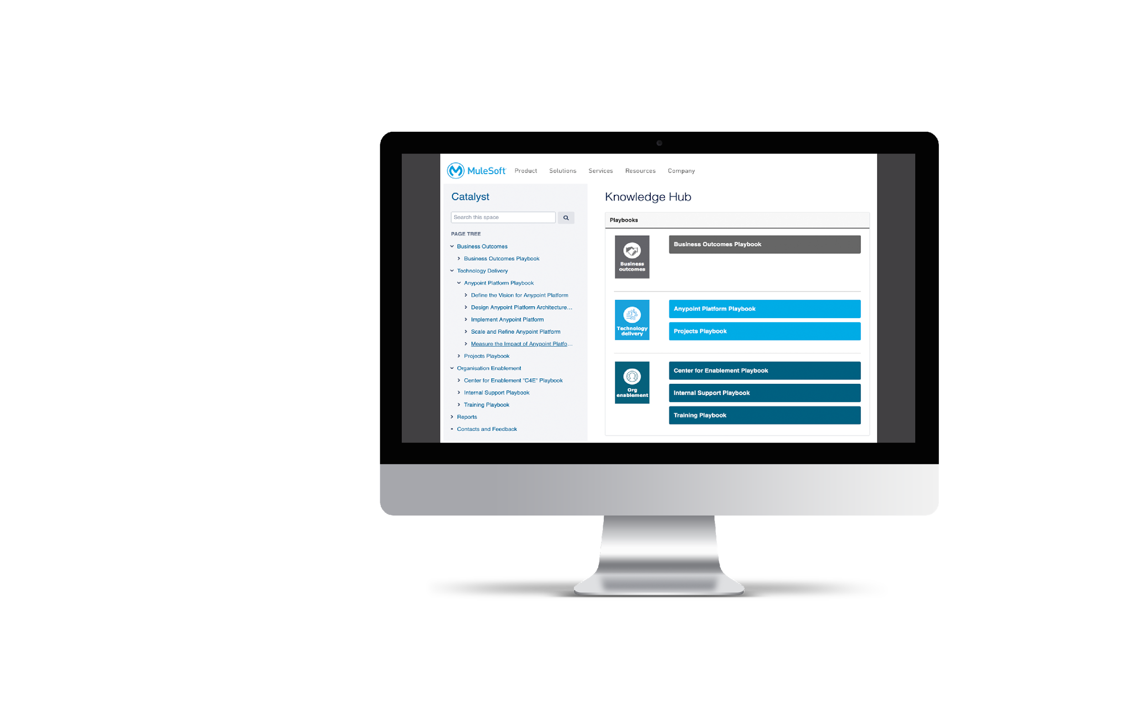
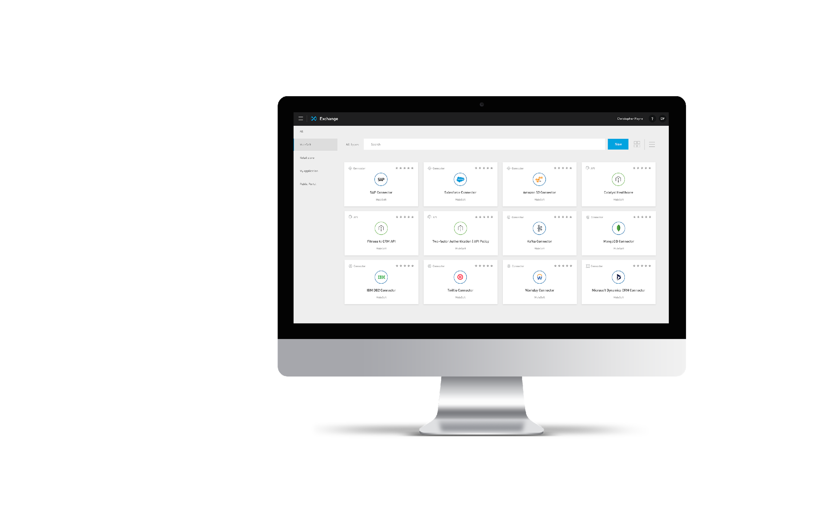
Technical assets via Anypoint Exchange
APIs
Connectors
Templates
Accelerators for Salesforce
Industry Accelerators
18
Notes:
Slide takeaway: We have technical assets that customers can use coming out the gate to help them accelerate success
Technical assets are available via the Mulesoft Anypoint exchange or public exchange. And there you will find API connectors, API templates, accelerators for Salesforce, industry accelerators, all of which you can download directly to your private exchange. And the reason that's exciting is all of these assets are designed and tested so that you and your team can build faster.

Slide 19
Best practices via Catalyst Knowledge Hub
250+ Best Practices
Design Guides
Architectures
Examples
C4E Models

Slide 20
Summary
MuleSoft Catalyst includes our unique methodology, our assets and our services
It is based on our experience working with over 1,700 customers
We share all of this to help our customers realize their business outcomes and achieve measurable value sooner
How can we help you change the clockspeed of your business?

Slide 22
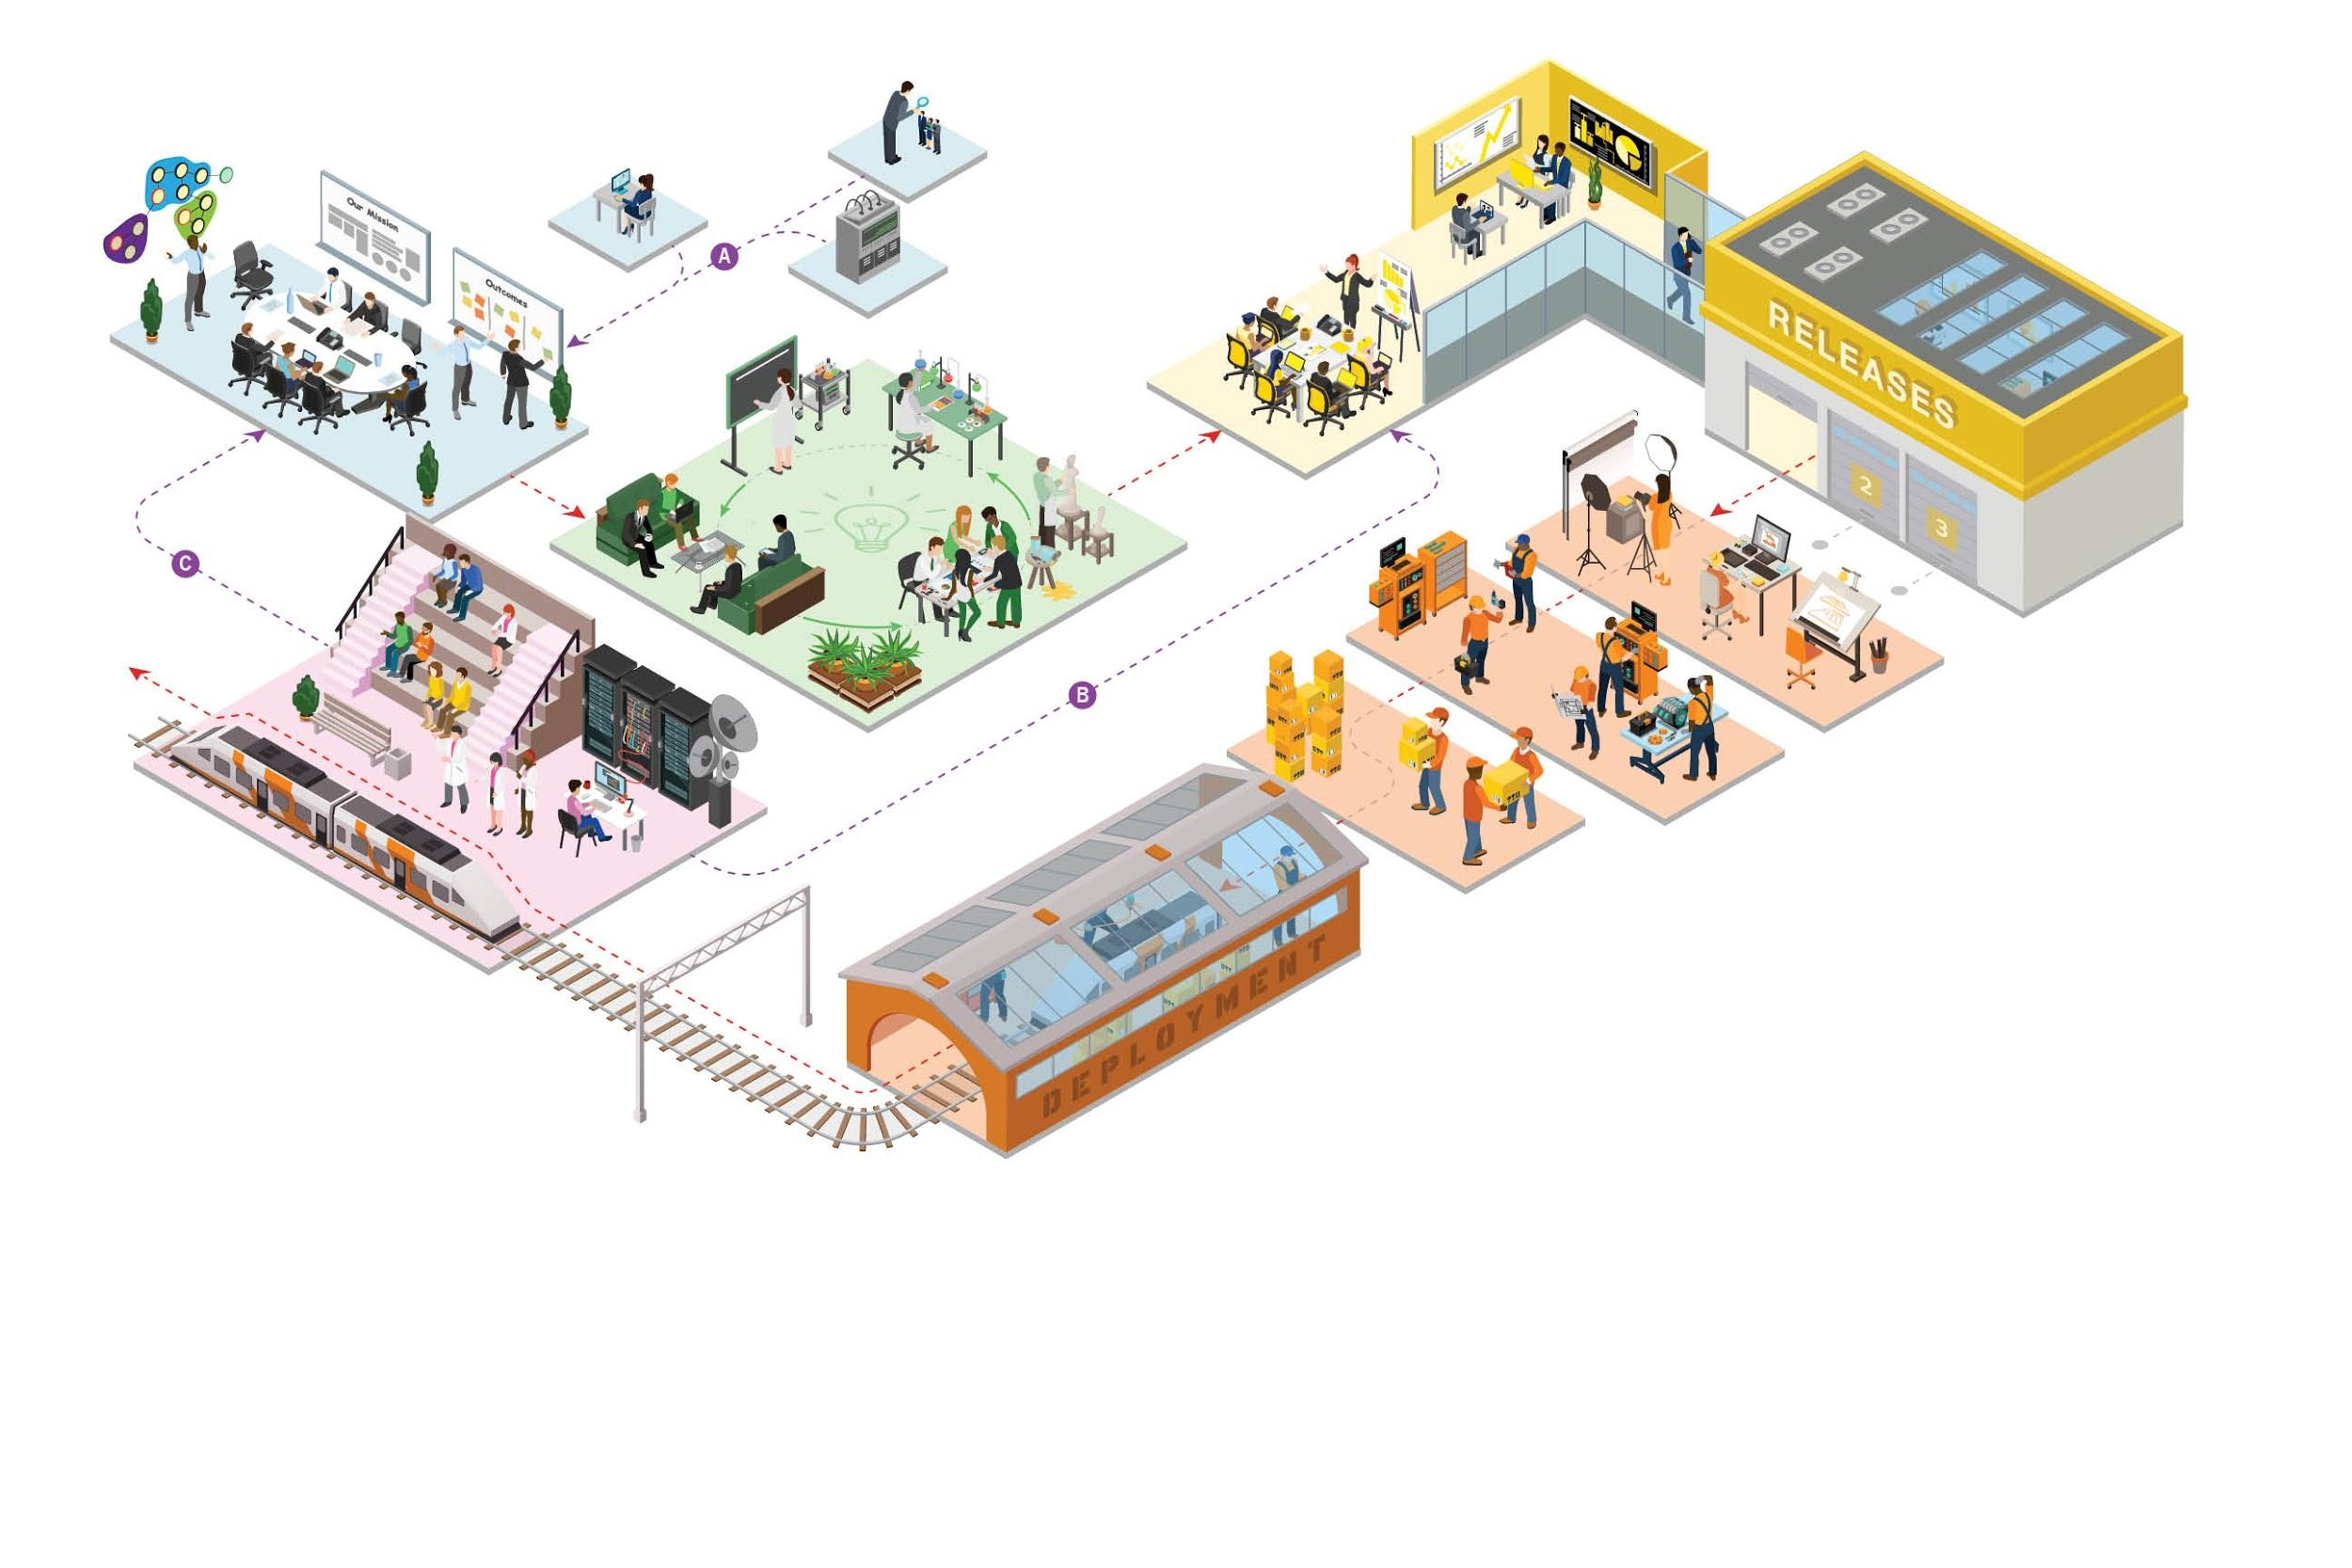
COE OPERATING MODEL
Focus on Mission Critical Outcomes
Digital Executive Team focus on performance and identify critical outcomes
Determine Areas to Innovate
Select Mission Critical Outcomes and Areas to innovate
Determine need for buy vs build
Provide guidance to PSEG product teams to prioritize
Solutioning
Mobilize cross functional teams to define extensible solutions for key personas and create meaningful inputs to roadmaps
Team guide prototyping to define clear use cases and designs including integrations
Integrate end-users to inform and test solutions in prototype form to drive rapid iteration on solutions
Enterprise Release Management
Define program epics and organize/prioritize work
Validate and refine the technical and Integration architecture and designs
Define Change Management adoption plans for business users aligned to critical outcomes
Plan & Design
Prioritize and groom backlog using continuous user feedback
Assign story points and load sprint
Develop QA, API led integration, adoption and training plans
Build Solution
Kick off PI and Sprints
Test solution through sprint demos with business users to seek additional feedback
Deploy Solution
Conduct UAT and End-to-End testing
Launch go-live plan
Launch go live adoption and training plans
Prepare Release & Launch
Create a Continuous Community of User Feedback
1
4
2
3
5
6
7
9
8
A
Sources
B
User Feedback
C
Strategic Feedback
Input on Industry trends, User research and Brand Experience
Break fix, small requests and small enhancements that can be resolved quickly
Organized user feedback focused on increasing value

Slide 23




OPERATING MODEL
Digital Steer Co
Council that is responsible for strategy and vision. Secures funding and determines funding investment allocation. Program success co-owners provide executive guidance and communication, identifies program gaps recommending strategies.It serves as an escalation path for both business groups and the IT organization.
Team that holds the delivery organization accountable to enable the outcomes and business owners accountable to drive their critical outcomes. It aligns business strategy to investment decision and manages the decision framework.
1
2
BEHAVIORS
Understand critical outcomes for each initiative and align to system capabilities
Develop initial roadmap to enable critical outcomes
Determine need for solution
Establish the design principles of the Operating Model
Possible PAIN POINTS
Lack of clarity around enterprise strategy and vision
No motion to validate value/design
No one view of prioritized work aligned to outcomes
Overlapping roles
Lack of Salesforce knowledge
OUTCOMES
Increase ability to measure value
Increased speed to value
Increase operational efficiency of the build
Increase BU satisfaction due to increased engagement
Define success criteria for platform
Likely GAPS
Business and Technical roles do not exist with sufficient Salesforce/MuleSoft expertise
Engagement of product teams and alignment of capabilities to target outcomes is inconsistent

Slide 24
OPERATING MODEL
Solutioning
Framework and supporting team to create or validate solutions to key business problems. Solutioning done to validate a problem, validate value, or validate a technical design. We do this before engaging the delivery teams.
3
BEHAVIORS
Test hypotheses before larger investments are made downstream
Create the solution framework and associated tools and processes
User research and business process discovery
Technical validation of solution and scalability test of solution
Possible PAIN POINTS
No validation of value/design vs. best practice
Lack of Salesforce/MuleSoft architecture skill sets
Limited adoption of current product capabilities and design principles
OUTCOMES
Increase ability to measure value
Increased speed to value
Increase operational efficiency of the build (known design and value)
Increase product team satisfaction due to increased engagement
Likely GAPS
This motion/function is not institutionalized in the current structure
Solution Lead role does not exist

Slide 25
OPERATING MODEL
Enterprise Release Management
Planning of the release cycle is the main objective of this motion. Defines program epics and organize the work into logical releases. Architects work on the validation of key architecture components. Adoption plans are then aligned to critical outcomes.
4
5
BEHAVIORS
Understand backlog items and associated technical designs
Organize backlog into a release based on priority and logical sequencing
Assign teams to release epics
Collaborate with business and tech on release content and timing
Understand use impact to plan training and adoption
Possible PAIN POINTS
Lack of established enterprise delivery methodology
Salesforce/Mulesoft platform skills
No visibility into demand
OUTCOMES
Clarity around release outcomes
Increased speed to value
Increase operational efficiency of the build (known design and value, and build with reusability in mind)
Increase BU satisfaction due to increased engagement
Likely GAPS
No one view of various workstreams (Internal vs vendor led)
Limited Continuous Delivery Pipeline (CDP) and Innovation Pipeline
Manual setup & refresh of environments

Slide 26
OPERATING MODEL
Build & Deploy Teams
Scrum teams groom the backlog using continuous user feedback and established COE processes, and assign story points to determine relative work effort. Acceptance criteria are assigned to each story and high level story tasks are documented along with any open questions for the business owner. QA, Adoption and training plans are developed.
Sprinting begins and solutions are validated with the business through sprint demos.
The release is readied for deployment and the go-live plan is executed.
7
6
8
BEHAVIORS
Ability to write quality user stories
Understand the technology platform to determine tasks to complete the work
Ability to manage scrum teams
Possible PAIN POINTS
Inconsistent delivery methodology due to lack of COE/C4E governance
Access to skilled Salesforce/Mulesoft delivery resources
OUTCOMES
Increased speed to value
Increase operational efficiency of the build (known design and value)
On time delivery from better scrum mgmt. and user story quality
Likely GAPS
Inability to scale to meet demand or deliver ontime
Manual processes exist with limited support of devops tools i.e. no Continuous Integration & Deployment
Limited visibility on build and deployment outcomes (i.e. no automated notification, dashboard & metrics)

Slide 27
OPERATING MODEL
Feedback
A framework established by the COE to continuously gather and engage with the users of a system is critical to drive adoption and deliver high value to the business. Engaging the user in an open manner allows for self service and crowd sourcing of user issues and feedback freeing up resources to focus on more strategic areas.
9
BEHAVIORS
Setup a feedback mechanism within the 360 application
Source ideas and requests
Explore the possibility to allow for open collaboration among all users
Solicit feedback at every step of delivery and operations
Possible PAIN POINTS
BU’s do not feel heard
Requests take a long time to resolve
OUTCOMES
Increased adoption
Increased speed to value
Increase operational efficiency
Increase BU satisfaction due to increased engagement
Likely GAPS
Feedback mechanism is very labor intensive and time consuming

